Slide 1

MATH 323
Graph Theory
Cr. 3
Dr. Bhadra Man Tuladhar
MATH 323 Graph Theory Lec. 9

Slide 2
Unlabelled Trees
Remember: - Theorem (Cayley’s Theorem)
The number of labeled trees with n vertices (n ≥ 2) is n^{n-2}.
The number of unlabelled trees with n vertices, denoted by T_{n}, is more difficult to handle.
MATH 323 Graph Theory Lec. 9

Slide 3
Unlabelled Trees
There is only one unlabelled tree with 1,2 or 3 vertices; there are two unlabelled trees with 4 vertices.
Such a tree is called a star.
MATH 323 Graph Theory Lec. 9

Slide 4
Unlabelled Trees
No. of Vertices | Labelled Trees | Unlabelled Trees
1 | 1 | 1
2 | 1 | 1
3 | 3 | 1
4 | 16 | 2
5 | 25 | 3
6 | 1296 | ?
… | ? | ?
MATH 323 Graph Theory Lec. 9

Slide 5
Unlabelled Trees
TRY
There are 3 unlabelled tree with 5 vertices. Draw these 3 trees.
MATH 323 Graph Theory Lec. 9

Slide 6
How to store a Tree?
We want to store the following labelled tree in a computer.
7
8
1
9
3
0
2
6
5
4
MATH 323 Graph Theory Lec. 9

Slide 7
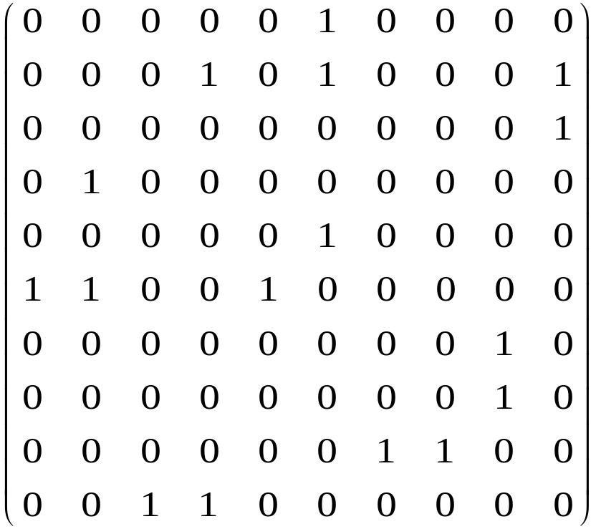
7
8
1
9
3
0
2
6
5
4
The adjacency matrix is

Slide 8
7
8
1
9
3
0
2
6
5
4
The adjacency matrix is
How many bits it takes to store this data?
n²

Slide 9
7
8
1
9
3
0
2
6
5
4
The adjacency matrix is
Observe the symmetry about the diagonal.
(n² – n)/2

Slide 10
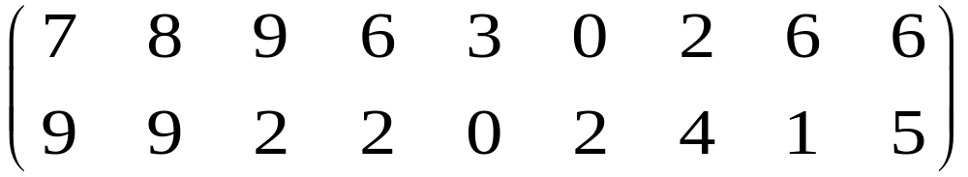
7
8
1
9
3
0
2
6
5
4
List in an array whose columns correspond to the edges.

Slide 11
7
8
1
9
3
0
2
6
5
4
How many bits it takes to store this array?
2n log₂n
why?

Slide 12
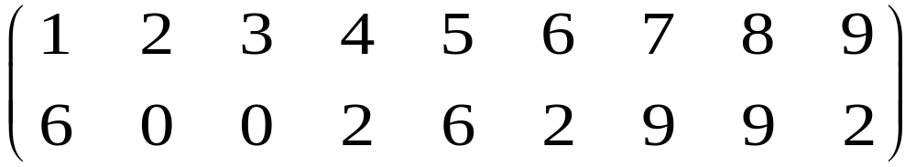
7
8
1
9
3
0
2
6
5
4
The father code.
How many bits it takes to store this array?
(n – 1) ⎡log₂n⎤
why?

Slide 13
7
8
1
9
3
0
2
6
5
4
Prüfer code.
Look for a vertex of degree 1, different from 0, with the smallest level, and write down the edge with this endnote. Then we delete this vertex and edge from the tree, and repeat: we look for the endnote with smallest level,

Slide 14
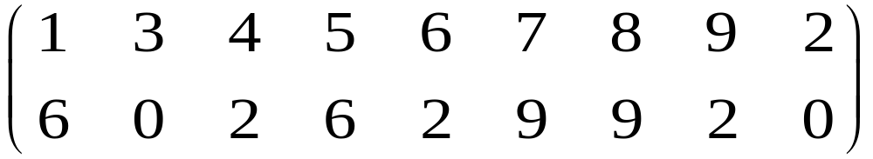
7
8
1
9
3
0
2
6
5
4
Prüfer code.
different from 0, and write down the edge incident with it. Then we delete this vertex and edge, etc. We go until all edges are listed.

Slide 15
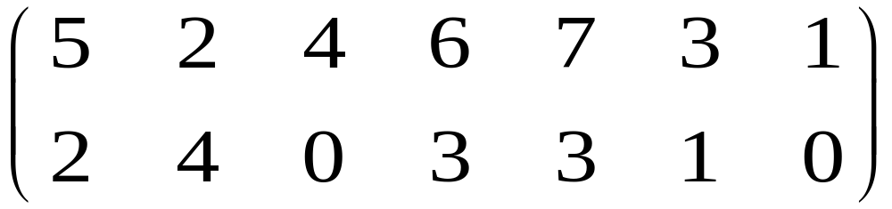
Exercise
Draw the tree that corresponds to the above Prüfer code.

Slide 16
Planar Graphs
Def.: A graph G is a planar graph, if the lines (or continuous curves) corresponding to the edges do not intersect each other except at their ends.
Def.: A drawing of a geometric representation of a graph G on any surface such that no edges intersect is called embedding of G.
Def: A graph that cannot be drawn on a plane without a crossover between its edges is called nonplanar.
MATH 323 Graph Theory Lec. 9

Slide 17
Planar Graphs
Planar graphs are useful in the design of
electrical (or similar) circuits, where one tries to (or has to) avoid crossing the wires or laser beams.
printed-circuit boards.
MATH 323 Graph Theory Lec. 9

Slide 18
Example 1
Three-utilities Problem
There are three houses H₁, H₂, and H₃, each to be connected to each of the three utilities – water (W), gas (G) and electricity (E) – by means of conduits.
Is it possible to make such connections?
H₁
H₂
H₂
Try to draw a planar graph.
W
G
E
Nonplanar!
MATH 323 Graph Theory Lec. 9

Slide 19
Example 2
G₁
G₂
Can we draw a graph with no intersection?
MATH 323 Graph Theory Lec. 9

Slide 20
Natural Question
How can we decide whether a given graph is planar or not?
To answer this question we discuss two nonplanar graphs of fundamental importance.
MATH 323 Graph Theory Lec. 9

Slide 21
Kuratowski’s Graphs
1. The complete graph of five vertices K₅ is nonplanar.
This is first graph of Kuratowski.
MATH 323 Graph Theory Lec. 9

Slide 22
Kuratowski’s Graphs
Complete bipartite graph K_{3,3} is nonplanar.
This is the second graph of Kuratowski.
This graph is isomorphic with the three-utilities problem.
MATH 323 Graph Theory Lec. 9

Slide 23
Some Properties of Kuratowski’s graphs
They are regular graphs.
They are nonplanar.
Removal of one edge or a vertex makes each a planar graph
First graph of Kuratowski is the nonplanar graph with the smallest number of vertices.
Second graph of Kuratowski is the nonplanar graph with the smallest number of edges.
Both are the simplest nonplanar graphs.
MATH 323 Graph Theory Lec. 9

Slide 24
Different Representations
Any simple planar graph can be embedded in a plane such that every edge is drawn as a straight line segment.
v₁
v₂
v₂
v₁
v₃
v₄
v₃
v₅
v₅
v₄
MATH 323 Graph Theory Lec. 9

Slide 25
Planar Graphs
-Common Misunderstanding
Just because a graph is drawn with edges crossing doesn’t mean its not planar.
Q: Why can’t we conclude that the following is non-planar?
MATH 323 Graph Theory Lec. 9

Slide 26
Planar Graphs
-Common Misunderstanding
A: Because it is isomorphic to a graph which is planar:
MATH 323 Graph Theory Lec. 9

Slide 27
Planar Graphs
-Common Misunderstanding
A: Because it is isomorphic to a graph which is planar:
MATH 323 Graph Theory Lec. 9

Slide 28
Planar Graphs
-Common Misunderstanding
A: Because it is isomorphic to a graph which is planar:
MATH 323 Graph Theory Lec. 9

Slide 29
Planar Graphs
-Common Misunderstanding
A: Because it is isomorphic to a graph which is planar:
MATH 323 Graph Theory Lec. 9

Slide 30
Planar Graphs
-Common Misunderstanding
A: Because it is isomorphic to a graph which is planar:
MATH 323 Graph Theory Lec. 9

Slide 31
Planar Graphs
-Common Misunderstanding
A: Because it is isomorphic to a graph which is planar:
MATH 323 Graph Theory Lec. 9

Slide 32
Planar Graphs
-Common Misunderstanding
A: Because it is isomorphic to a graph which is planar:
MATH 323 Graph Theory Lec. 9

Slide 33
Planar Graphs
-Common Misunderstanding
A: Because it is isomorphic to a graph which is planar:
MATH 323 Graph Theory Lec. 9

Slide 34
Planar Graphs
-Common Misunderstanding
A: Because it is isomorphic to a graph which is planar:
MATH 323 Graph Theory Lec. 9

Slide 35
Unlabelled Trees
Remember: - Theorem (Cayley’s Theorem)
The number of labeled trees with n vertices (n ≥ 2) is n^{n-2}.
The number of unlabelled trees with n vertices, denoted by T_{n}, is more difficult to handle.
MATH 323 Graph Theory Lec. 9

Slide 36
Unlabelled Trees
There is only one unlabelled tree with 1,2 or 3 vertices; there are two unlabelled trees with 4 vertices.
Such a tree is called a star.
MATH 323 Graph Theory Lec. 9

Slide 37
Unlabelled Trees
No. of Vertices | Labelled Trees | Unlabelled Trees
1 | 1 | 1
2 | 1 | 1
3 | 3 | 1
4 | 16 | 2
5 | 25 | 3
6 | 1296 | ?
… | ? | ?
MATH 323 Graph Theory Lec. 9

Slide 38
Unlabelled Trees
TRY
There are 3 unlabelled tree with 5 vertices. Draw these 3 trees.
MATH 323 Graph Theory Lec. 9

Slide 39
Homeomorphism
The graphs G₁ and G₂ are homeomorphic if one can be obtained from the other by
  one or more replacements of a degree 2 vertex and its incident edges with a single edge, or
  one or more placements of a vertex on an edge in such a way that the edge becomes two edges that share the new vertex as a degree 2 vertex.
MATH 323 Graph Theory Lec. 9

Slide 40
Homeomorphic graphs
These three graphs are homeomorphic:
MATH 323 Graph Theory Lec. 9

Slide 41
Kuratowski Theorem
A graph is planar if and only if it contains no subgraph homeomorphic to K₅ or K_{3,3} .
MATH 323 Graph Theory Lec. 9

Slide 42
Regions
A plane representation of a graph divides the plane into regions.
r₁, r₂, r₃, r₄ and r₅ are finite regions.
r₆ is an infinite region.
r₁
r₆
r₂
r₃
r₄
r₅
MATH 323 Graph Theory Lec. 9

Slide 43
Euler’s Formula
A connected planar graph with n vertices and e edges has e – n + 2 regions.
[Euler’s formula: region r = e – n + 2]
In any simple, connected planar graph with r regions, n vertices and e edges (e>2), the following inequalities must hold:
2e ≥ 3r,
e ≤ 3n – 6.
MATH 323 Graph Theory Lec. 9

Slide 44
Exercise
Verify the Euler’s formula for the following graphs:
a.
b.
c.
MATH 323 Graph Theory Lec. 9

Slide 45
More Exercises
2. A complete graph K_{n} is planar if and only if n ≤ 4.
3. A complete bipartite graph K_{m,n} is planar if and only if m ≤ 2 or n ≤ 2.
MATH 323 Graph Theory Lec. 9

Slide 46
Kuratowski Theorem
The graphs K₅ and K_{3,3} are nonplanar.
MATH 323 Graph Theory Lec. 9

Slide 47
Story Time
MATH 323 Graph Theory Lec. 9

Slide 48
Story of
Narayan
& Narad
MATH 323 Graph Theory Lec. 9

Slide 49
More Next Time
MATH 323 Graph Theory Lec. 9

